Slide 1
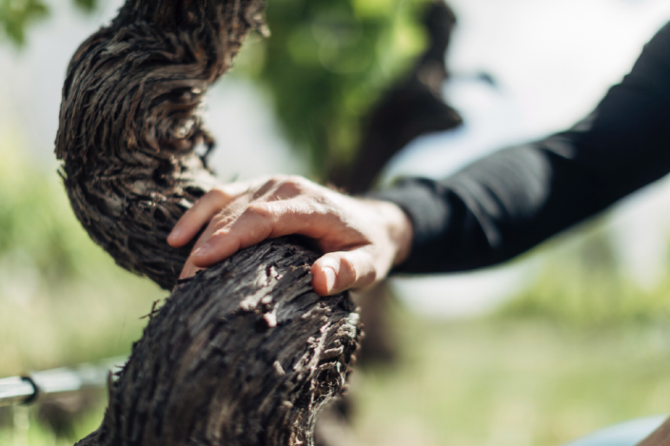
AUSTRALIA’S OLD VINES

Slide 2
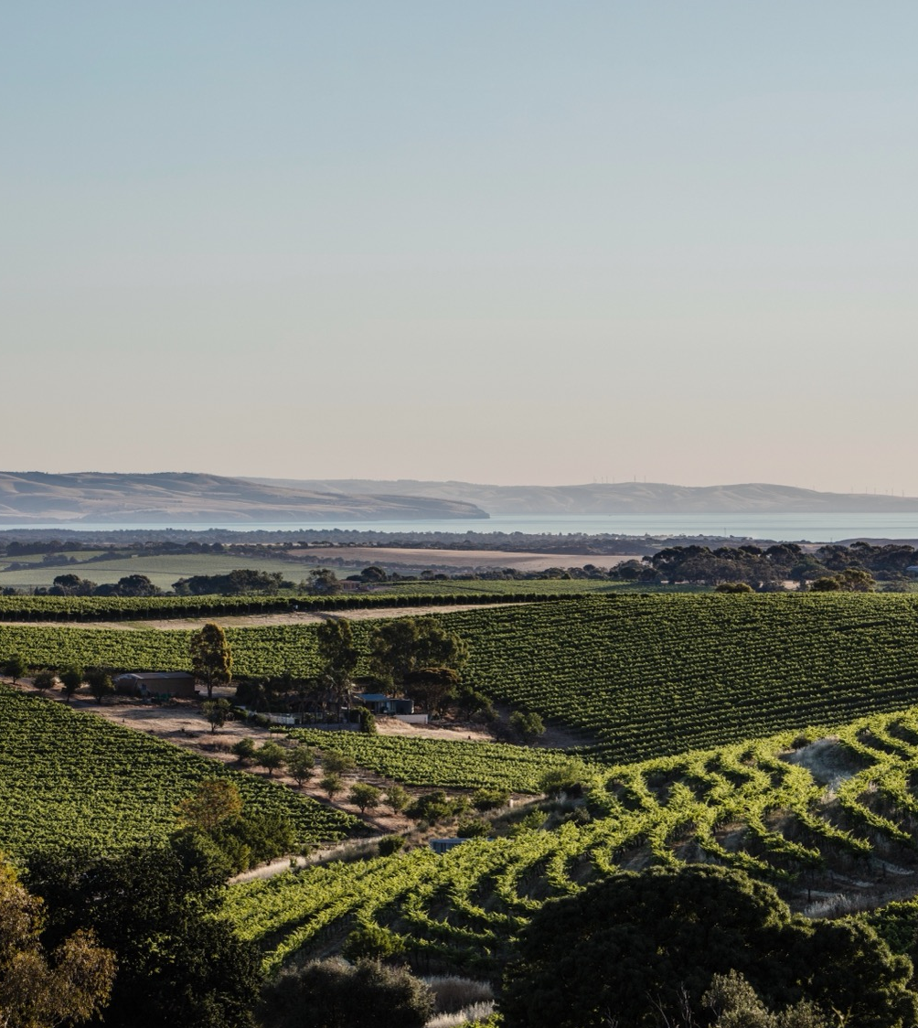

Crafted from grapes grown under vast and diverse climates, across landscapes millions of years in the making, every glass of Australian wine tells a story.
Like those who came before us, our modern growers and makers continue to be passionate, resilient and creative; constantly driven to explore new ways to perfect old techniques. Our community is connected by a mutual respect and shared love of crafting exceptional wine, while protecting the natural wonders for future generations to enjoy. Applying modern thinking to our ancient lands, we take playful experimentation very, very seriously.
So, if you’re looking for the taste of adventure, let Australian wine be your compass. Because in every bottle of Australian wine, you’ll experience the wonders of Australia – a reminder of the adventure and diversity that defines our culture and our land.

Slide 3
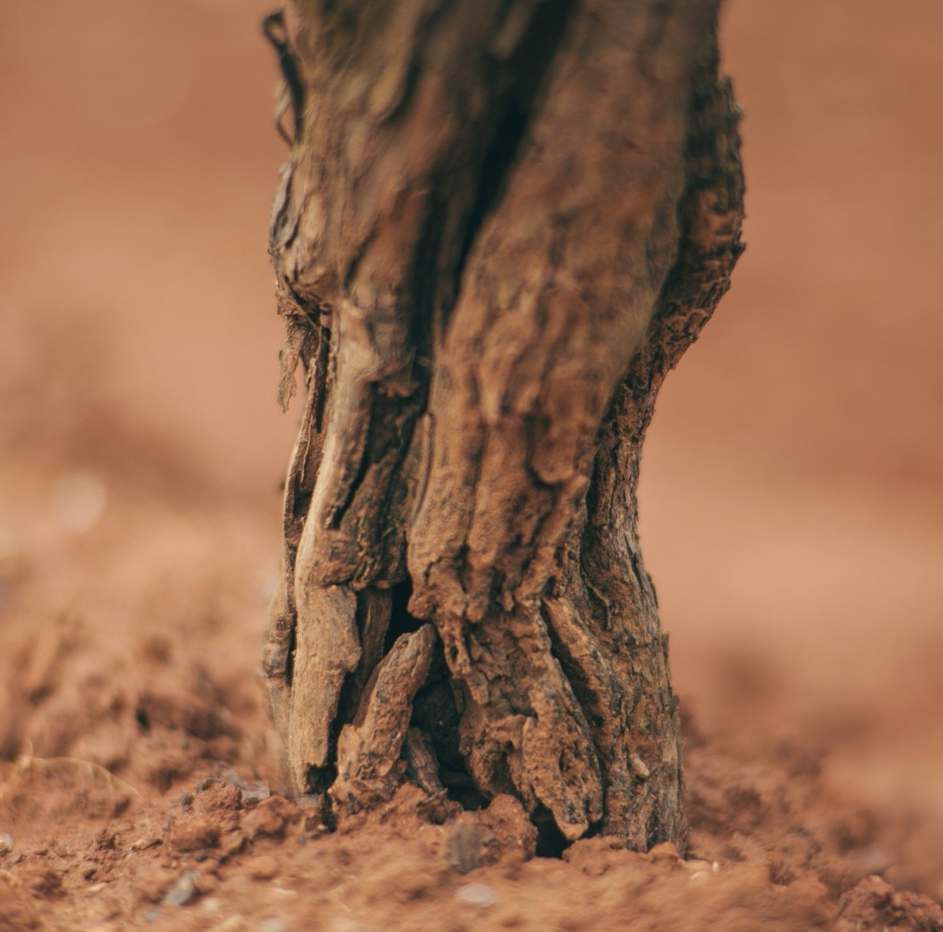
TODAY
WE’LL
COVER
History of Australia’s old vines
The definition of ‘old’ vines
Do old vines mean better wines?
Australia’s old-vine regions and material

Slide 4
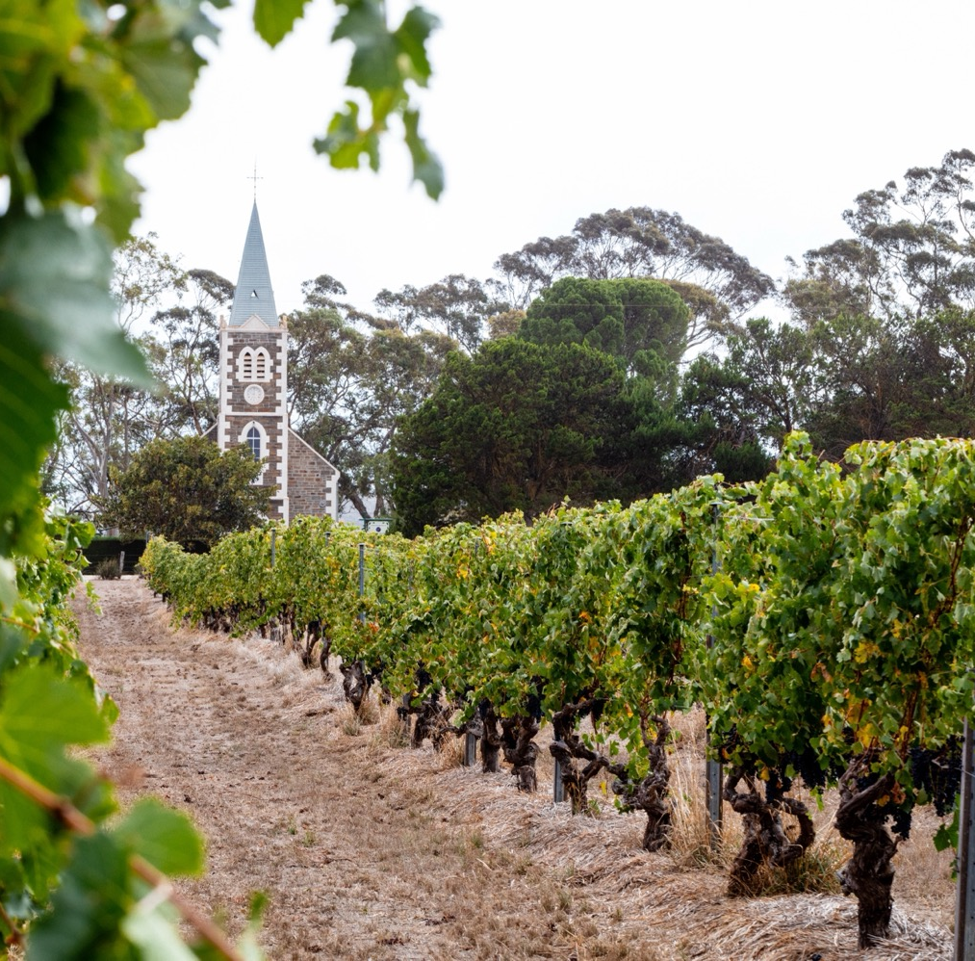
HOME TO SOME OF THE OLDEST VINES, OLDEST GEOLOGY AND MOST COMPLEX TERROIRS IN THE WORLD
Pioneering grape growers and winemakers
Pre-phylloxera vine stock
Early wine success
The launch of Australia’s multigenerational winemaking families

Slide 5
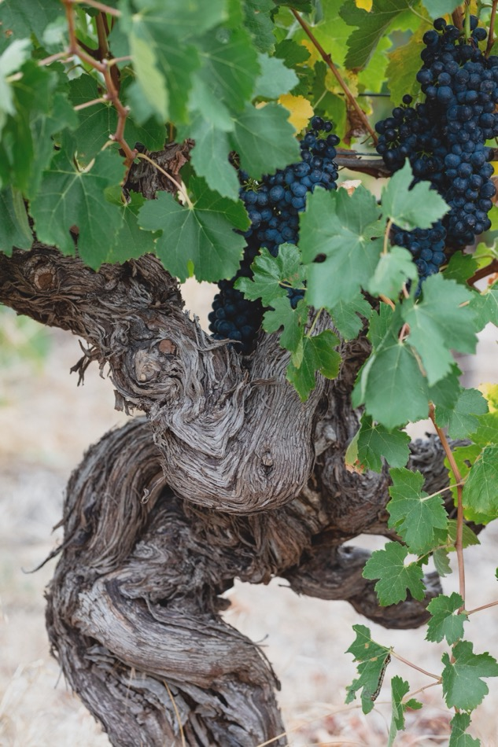
1832
James Busby’s significant collection of vine cuttings arrives in Australia
A BRIEF HISTORY
1788
1840s – 1870s
Australia’s first vines planted in Sydney’s Botanic Garden
A number of Australian vineyards planted during this time still produce grapes today – some of the oldest surviving and continuously producing vines in the world

Slide 6
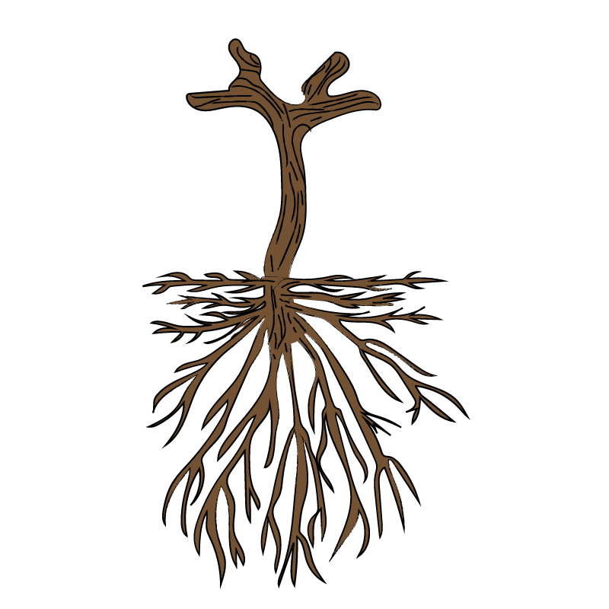
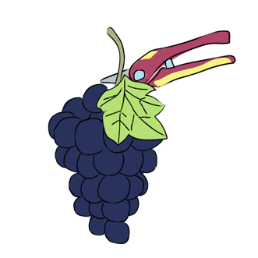
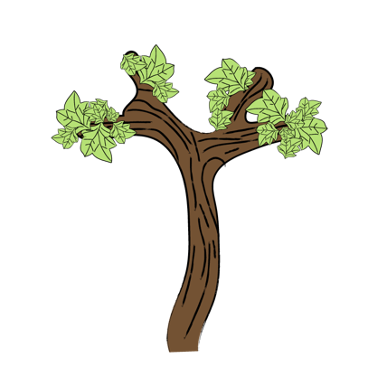
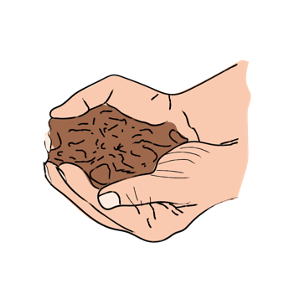
OLD VINES DEFINED
LARGE VOLUME OF PERENNIAL WOOD
YIELD LIMITING FACTORS
BALANCED GROWTH
PROVEN SITE SELECTION

Slide 7
BAROSSA
OLD VINE CHARTER
HOW OLD IS OLD
ANCESTOR VINES
CENTENARIAN WINES
SURVIVOR VINES
OLD VINES
35+
70+
100+
125+
YEARS

Slide 8
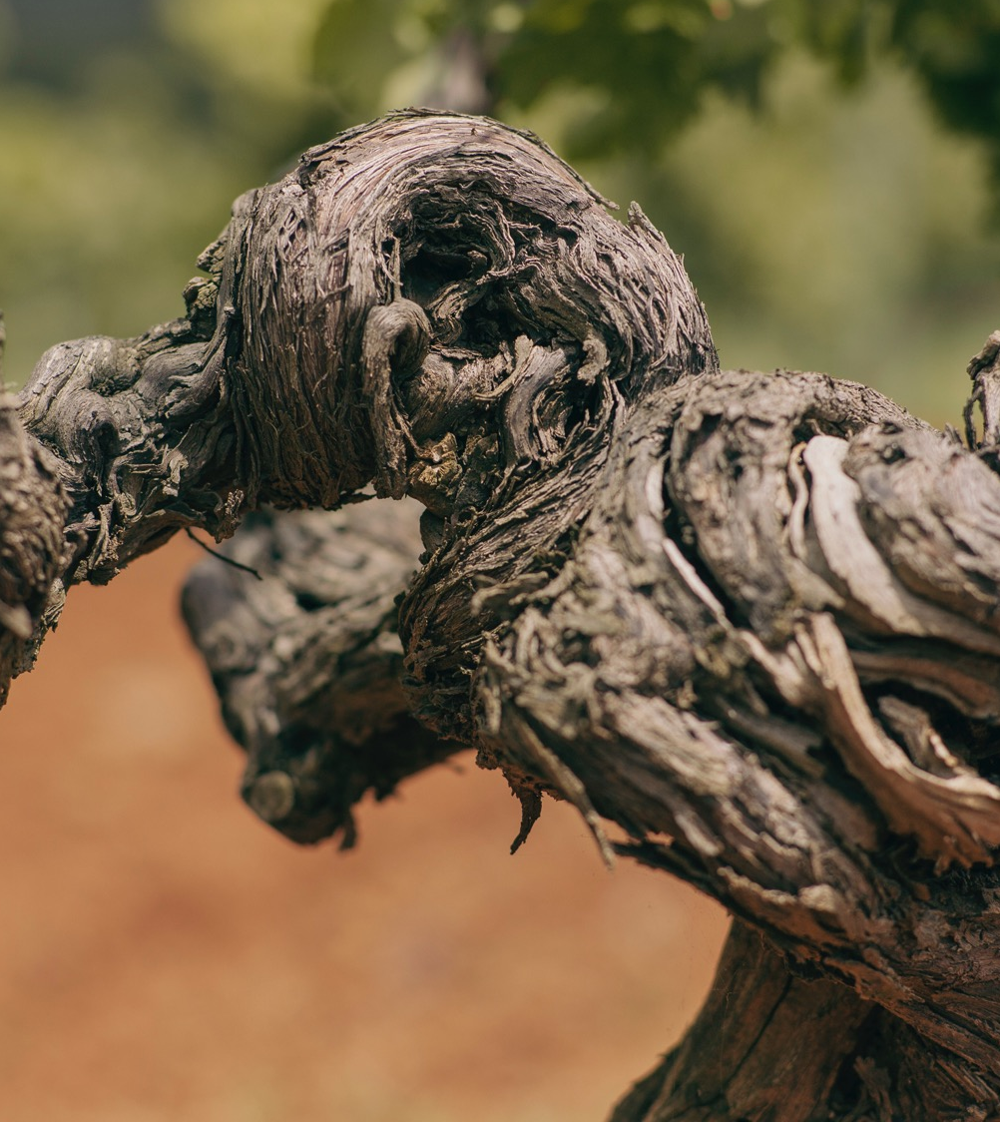
DO OLD VINES MAKE BETTER WINES?
Old vines versus young vines
Factors influencing old-vine wines
Passion and place

Slide 9
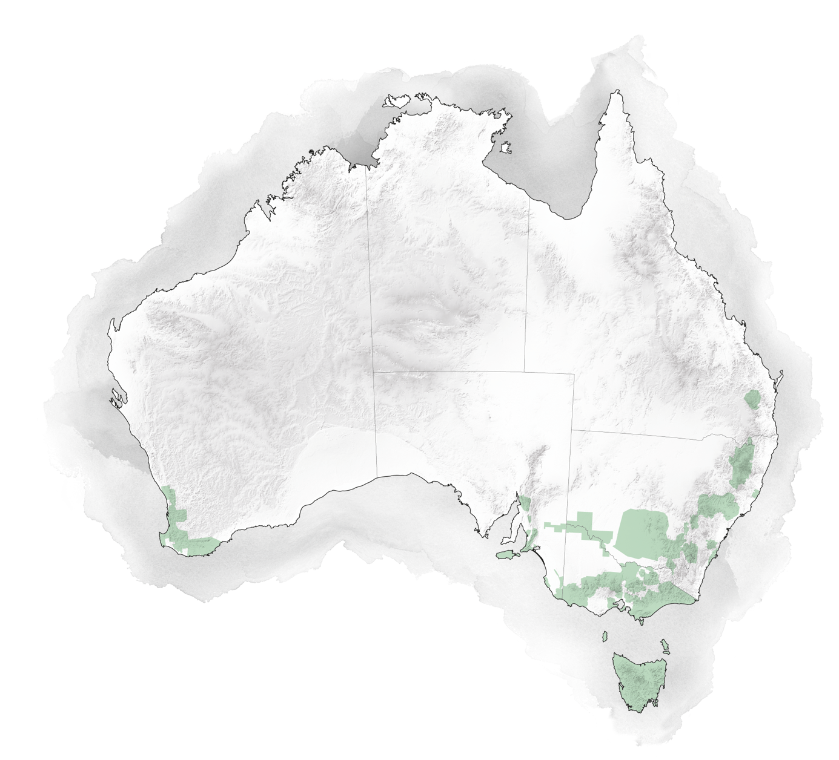
AUSTRALIA’S
OLD-VINE
WINE REGIONS
NORTHERN TERRITORY
QUEENSLAND
WESTERN AUSTRALIA
SOUTH AUSTRALIA
CLARE VALLEY
NEW SOUTH WALES
HUNTER VALLEY
BAROSSA
SWAN VALLEY
McLAREN VALE
LANGHORNE CREEK
VICTORIA
RUTHERGLEN
NAGAMBIE LAKES
GREAT WESTERN
TASMANIA

Slide 10
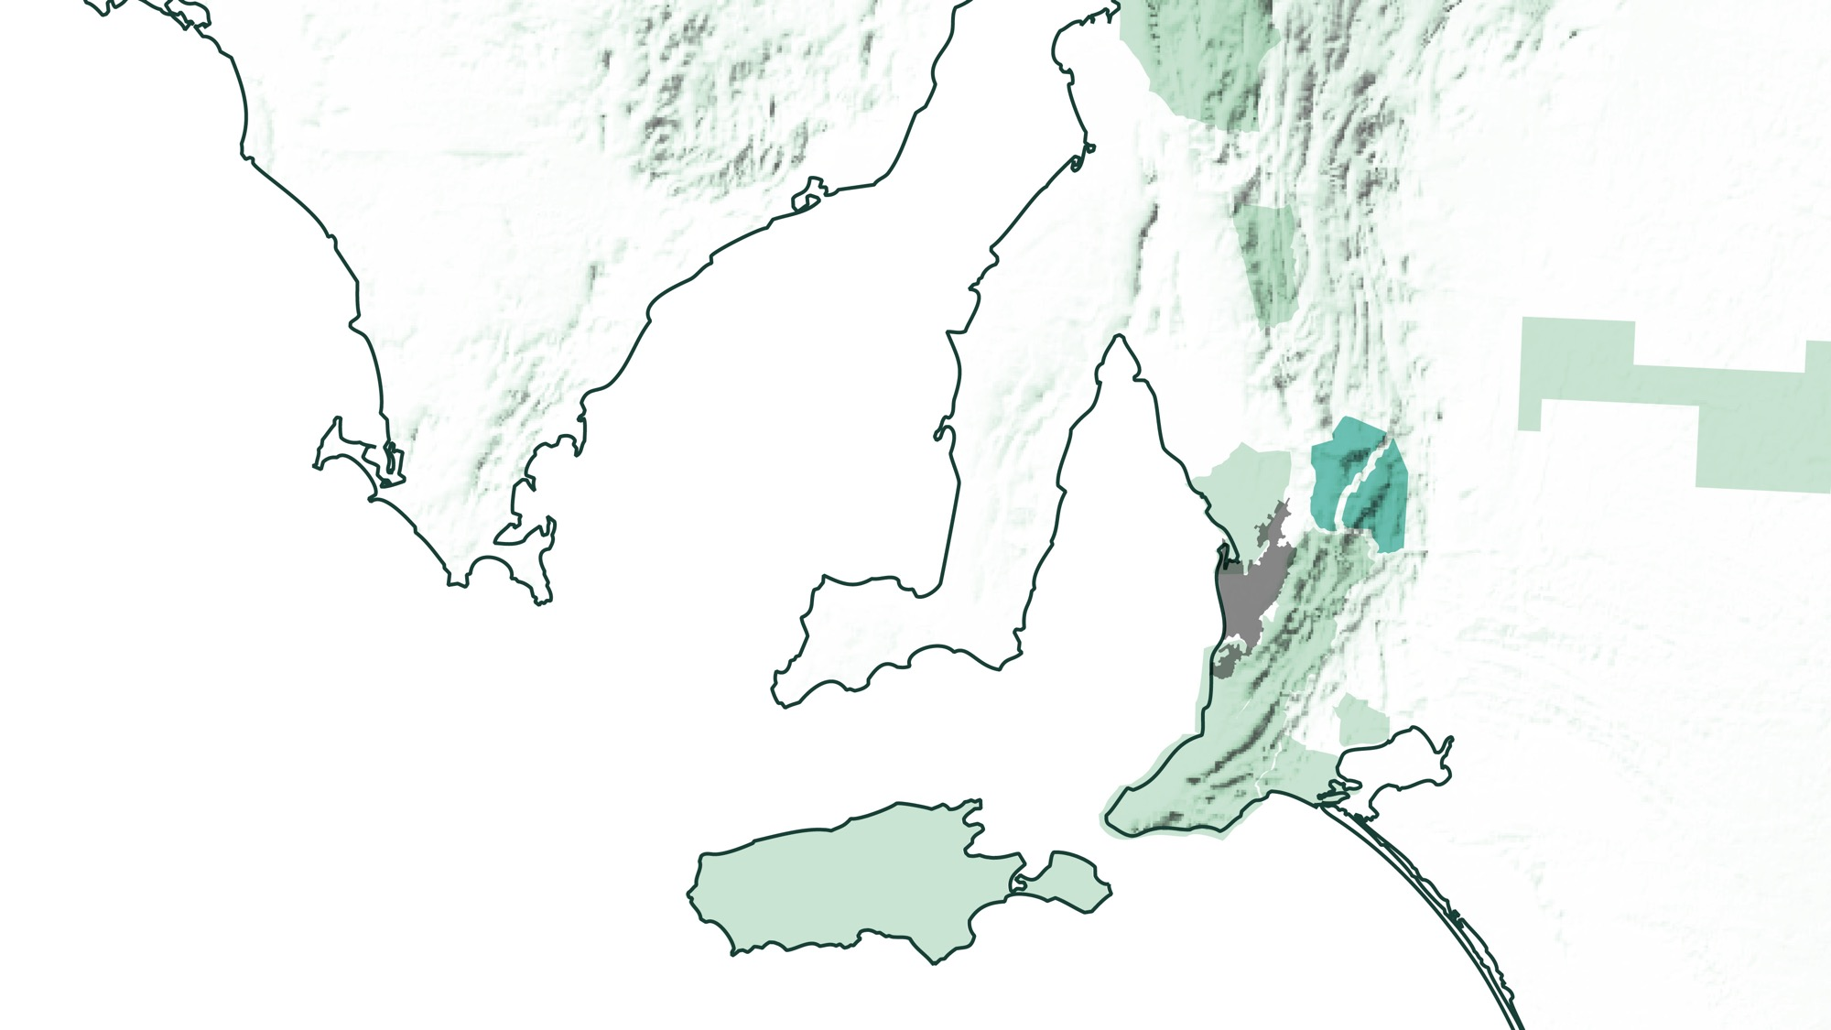
BAROSSA VALLEY
EDEN VALLEY
Adelaide
SOUTH AUSTRALIA

Slide 11

BAROSSA
Vines dating back to 1842
Home to some of the world’s oldest Shiraz, Mourvèdre and Grenache vines
Barossa old-vine varieties:
    Shiraz
    Mourvèdre
    Grenache
    Cabernet Sauvignon
    Riesling
    Chardonnay
    Semillon

Slide 12
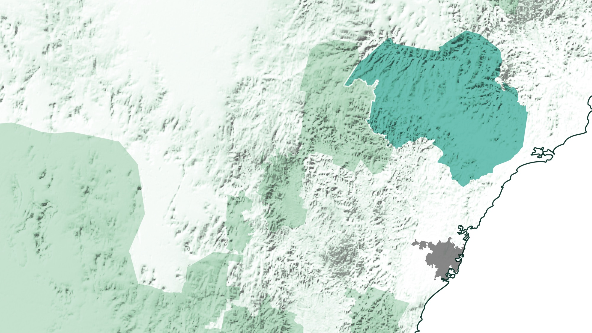
NSW
HUNTER VALLEY
Newcastle
Sydney

Slide 13
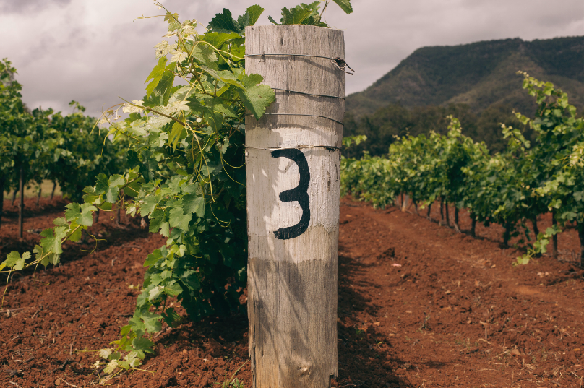
HUNTER VALLEY
Vineyards dating back to the 1860s
A significant amount of old vines (mostly Shiraz) growing on its own roots
Tyrrell’s Wines, which has been Australian-family-owned since 1858, is known for its six ‘Sacred Sites’ old‑vine blocks
Charles King planted Shiraz in the Old Hill vineyard at Mount Pleasant in 1880, making those vines some of the oldest in the Hunter Valley

Slide 14
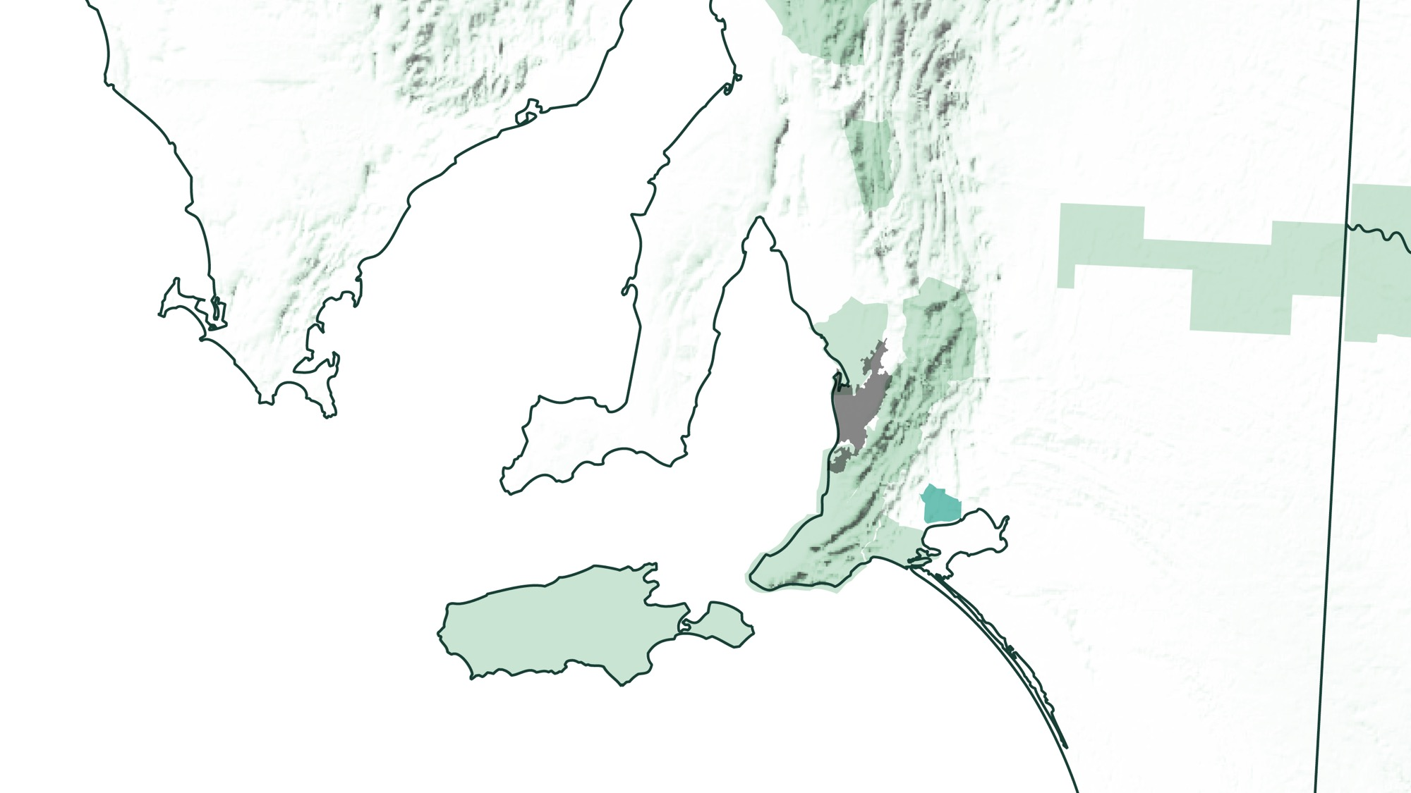
Adelaide
SOUTH AUSTRALIA
LANGHORNE CREEK

Slide 15
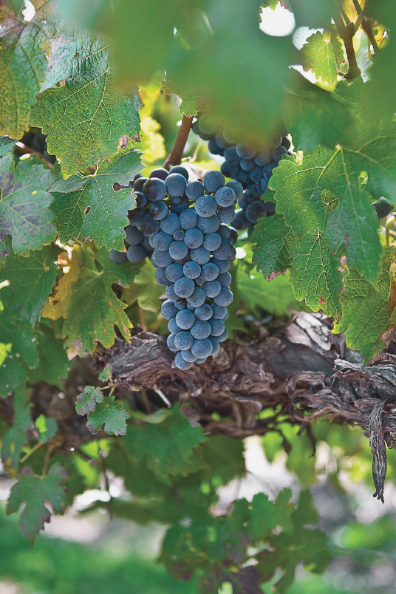
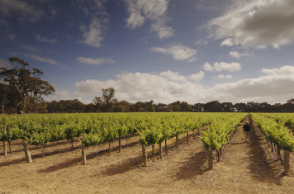
Langhorne Creek
Home to the world’s oldest family-owned Cabernet Sauvignon vines, planted in 1891 at the Metala vineyard.
Credit: FPT/Adam Bruzzone

Slide 16
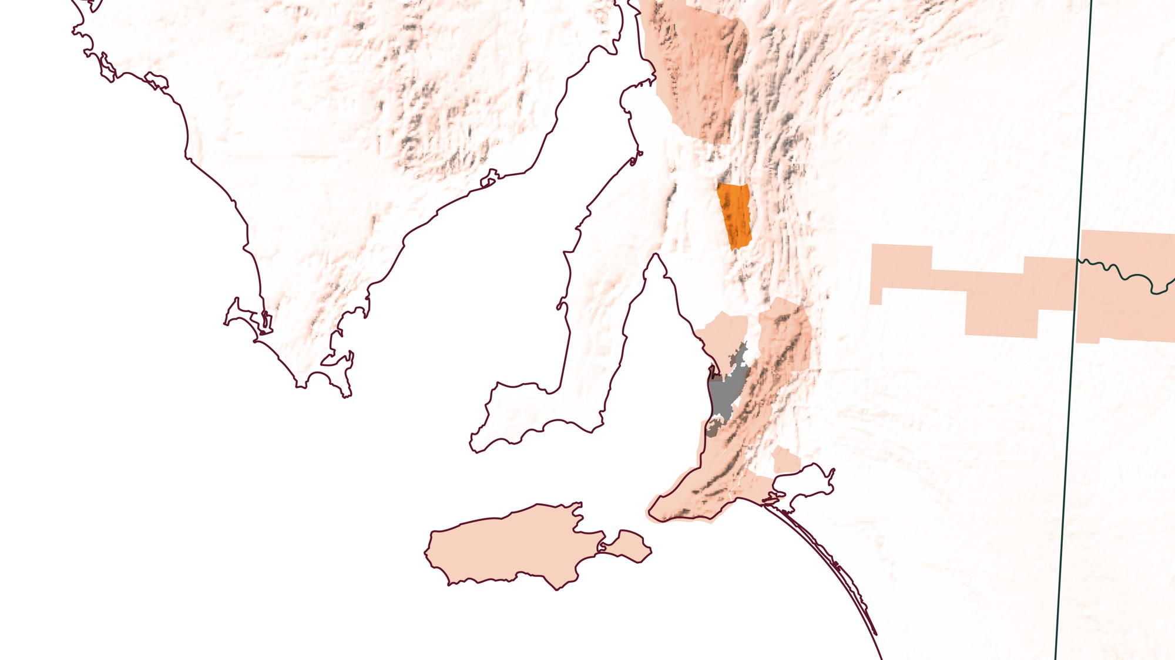
CLARE VALLEY
Adelaide
SOUTH AUSTRALIA

Slide 17
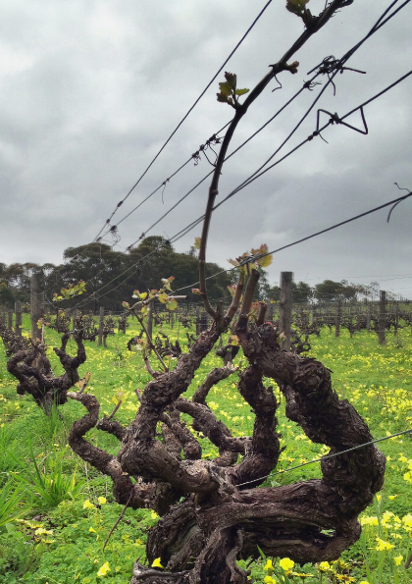
CLARE
VALLEY
Wendouree Cellars’ claim to fame is its prized old-vine Shiraz. First planted in 1893, these dry‑grown vines are still producing beautiful fruit today.

Slide 18
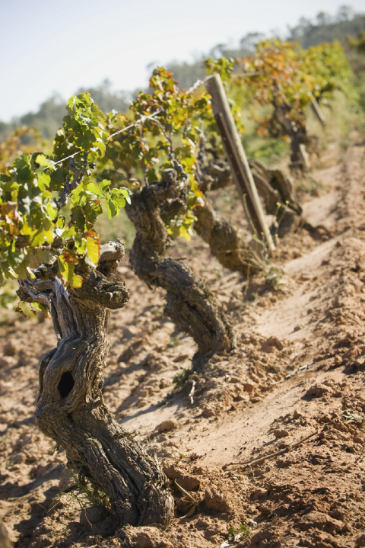
AUSTRALIA’S other old-vine regions and sites
Tahbilk in Nagambie Lakes, the oldest winery in Victoria, boasts the oldest Marsanne vines – planted in 1927 – and the largest single acreage of Marsanne in the world.
The famed Nursery Block at Best’s Wines in Great Western is believed to hold the most extensive collection of pre-phylloxera plantings in Australia – and possibly the world.
Because of the scarcity of its Pinot Meunier plantings, Best’s winery makes this wine only in the best vintages.
Rutherglen, once a gold mining town, famed for its fortified wines.

Slide 19
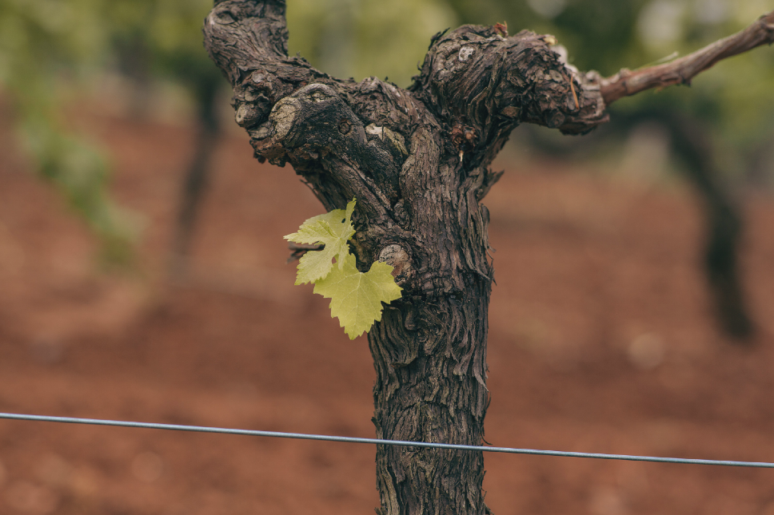
OLD VINES
NEW WAYS
Home to a rich winemaking history, with some of the oldest geology and most complex terroirs in the world, Australia’s vineyards are cultivated by multigenerational winemaking families. Australian wine is an expression of place: both where we are, and where we’re going next.

Slide 20
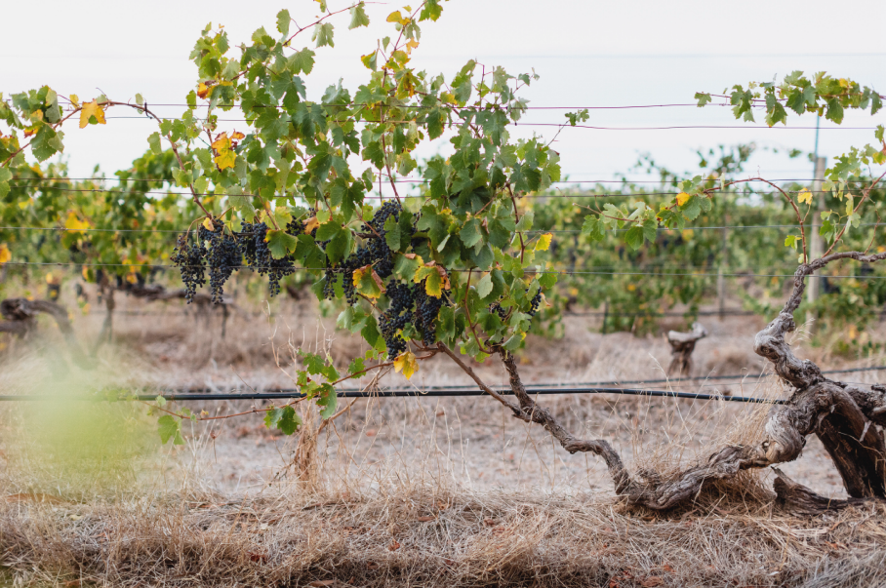
THANK YOU

